Slide 1
May
2024
Monthly Broker Slides

Slide 2
NAR Settles Lawsuit
Update as of May 7, 2024:
June 18 –
Deadline for REALTOR® MLSs to execute Appendix B (to be included as a released party)
Deadline for brokerages to execute Appendix C (to be included as a released party)
Deadline for non-REALTOR® MLSs to execute Appendix D (to be included as a released party)
August 17 –
Earliest date for Plaintiffs to issue case notice
New NAR MLS policy takes effect to implement practice changes
Deadline for REALTOR® MLSs to implement policy changes pursuant to mandatory NAR policy
National Association of REALTORS® reaches agreement to resolve nationwide claims brought by home sellers.
Press Release
NAR Fact Sheet – Read the details of NAR’s action
NAR Q & A – Frequently asked questions about the settlement, for NAR Members
Mainstreet Resource – Keeping our members informed of the latest industry news and information
Schedule an office visit today - email Lynnette@succeedwithmore.com

Slide 3
Spire

Slide 4
International Survey
https://www.surveymonkey.com/r/XB337DG

Slide 5
Congratulations!

Slide 6
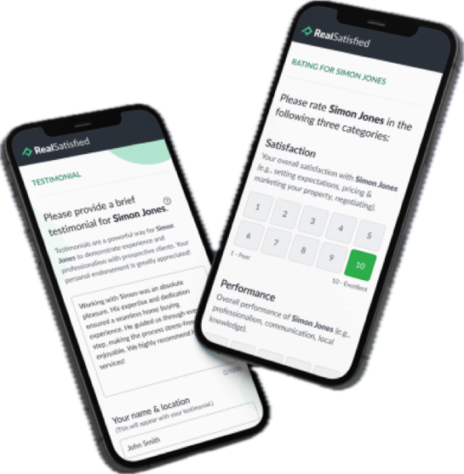
RealSatisfied
NEW- The Testimonial and Rating Request is live and ready to help you gather customer feedback quickly!
The Testimonial and Rating survey will allow you to collect a testimonial and rating from your client without survey questions. It’s quick and easy for your client.
The Testimonial and Rating Request is already available in your Agent Dashboard – simply choose it from the list when sending a survey notification.
What does the Testimonial and Rating survey look like? Send yourself a test survey: https://profile.realsatisfied.com/survey/US
Haven’t claimed your complimentary Agent Lite account? www.succeedwithmore.com/realsatisfied

Slide 7
Upcoming Courses & Events
June
1031 Presentation
Boost: Unlocking Success in Buyer Agency
SRS: Seller Representative Specialist
Commercial Boot Camp
Coffee & Conversation: NAR Settlement – What you need to know

