Slide 1
JULY 2023
BROKER SLIDES

Slide 2
LET MAINSTREET ASSIST YOU!
The Big ReThink
Mainstreet hosted four off-site events during the month of June exclusive to Designated Managing Brokers and Broker Owners to provide information and resources on the current lawsuits, DOJ settlement, value proposition and how Mainstreet can help you when speaking with Agents, Buyers and Sellers.
The Big ReThink Recording:
https://vimeo.com/843340896
The Big ReThink Power points
https://www.succeedwithmore.com/Career-Resources/designated-managing-brokers/
Buyers Representation Agreements
Exclusive
https://www.succeedwithmore.com/globalassets/member-locked-files/contracts-and-forms/residential-property/exclusive-buyer-representation-agreement2.pdf
Non-Exclusive
https://www.succeedwithmore.com/globalassets/member-locked-files/contracts-and-forms/residential-property/non-exclusive-buyer-rep.pdf

Slide 3
LATEST NEWS!
MLS PIN settles commission case
Key Points:
The proposed settlement covers MLS PIN only, a broker-owned MLS in Massachusetts
The settlement included to remove the mandatory requirement of compensation.
While not a legal precedent, the deal “will certainly” come up at trial in other cases
Anywhere, HomeServices of America, RE/MAX and Keller Williams are also defendants in the suit and have not settled
Click here to read more information

Slide 4
SENTRILOCK
Coming This Fall: Changes to one-day codes through ShowingTime
Out of area agent who doesn’t have access to SentriKey Real Estate App will be sent an invitation to download SentriConnect and then access will be granted through the app for their scheduled appointment vs receiving a one-day code
If the agent has access to the SentriKey Real Estate App they then will be asked to use their app vs receiving a one-day code
If agent who has access to the SentriKey Real Estate app refuses to use their app they will receive instructions on how to download SentriConnect and they will be granted access through the SentriConnect app
If the box is a non-bluetooth lockbox the code will be generated through the SentriConnect or SentriKey Real Estate apps at scheduled appointment time.

Slide 5
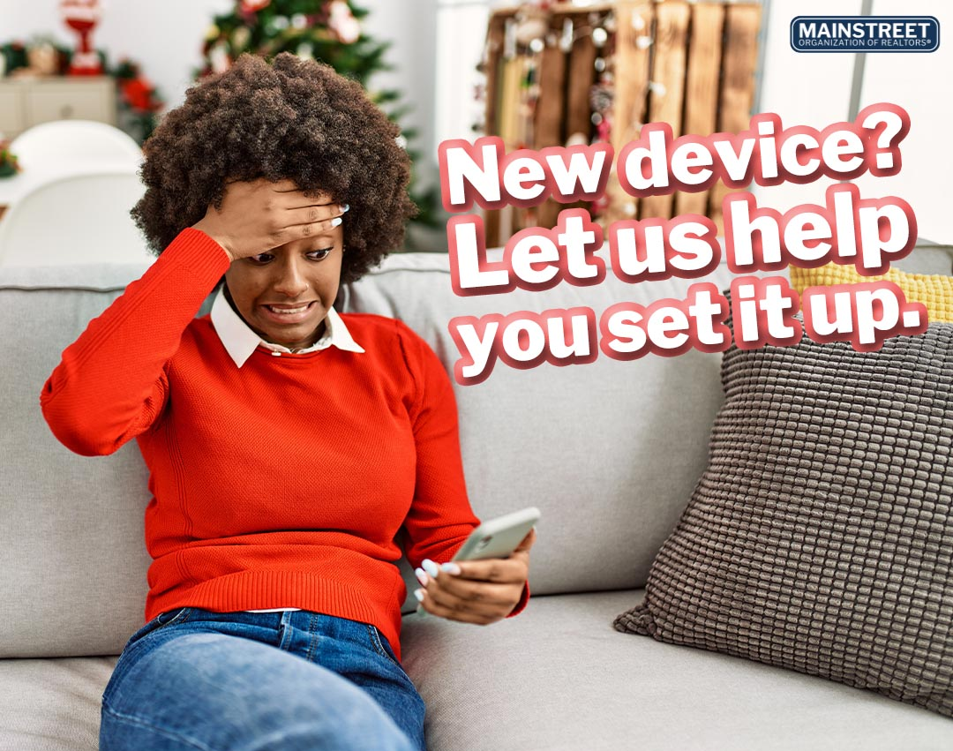
MEMBER BENEFIT: TECH HELPLINE
There's no need to sign up for anything, your account is attached to your active Mainstreet REALTORS® membership and is ready to be used when you need it. When you need assistance, the process is simple:
Contact Tech Helpline via phone, live chat or email
They’ll verify your active Mainstreet REALTOR® membership
They’ll troubleshoot the problem or provide answers to your questions

Slide 6
UPCOMING COURSES AND EVENTS
8.1.23 Financial Analysis for Commercial Investment Real Estate
8.6.23 Mainstreet Night at the Ballpark
8.10.23 Market Meet Up with Polish Real Estate Federation
8.12.23 Mainstreet Senior Expo
8.14.23 45Hour Post Licensing
8.17.23 Coffee & Conversation: How We Got Here
8.19.23 New Member Boost: Session 3
8.22.23 Propel Tech Event - Schaumburg
8.23.23 American Warrior Real Estate Professional
8.24.23 Brokerage Forum – Office Policy
8.29.23 SRS: Seller Representative Specialist
8.23.23 Global Entry Interview Day at Mainstreet
SucceedWithMORe.com/calendar

