Slide 1
MAY 2023
BROKER SLIDES

Slide 2
PRIVATE LISTING UPDATE
MRED Change Effective June 1, 2023
Offers of compensation in MRED Private Listings will be OPTIONAL.
As a listing broker, it is important to discuss your company policies related to compensation, provide them with your professional advice, and how those decisions might affect their marketing position.
If no compensation is offered, buyer brokers will need to discuss how to proceed with their buyers, possibly including:
Requesting compensation from the listing broker, using the Brokerage to Brokerage Cooperating Compensation Agreement
If the buyer is able to compensate the buyers’ broker, use the Exclusive or Non-Exclusive Buyer Representation Agreement
If not, discuss with the buyer how they would like to proceed.
Brokers should be able to effectively communicate their value proposition to their clients
Consider taking the Accredited Buyer’s Representative (ABR) Course
Visit competition.realtor

Slide 3
PRIVATE LISTING UPDATE
MRED Change Effective June 1, 2023
Brokers should be able to effectively communicate their value proposition to their clients
Consider taking the Accredited Buyer’s Representative (ABR) Course and Seller Representative Specialist (SRS) to help you define your value and impacts to your clients
Visit competition.realtor
Visit thedifference.realtor

Slide 4
MAINSTREET COMMITTEE SIGN UP OPEN
2023-2024 Mainstreet Volunteer Committee Applications Now Open!
Deadline to Submit Applications is May 31
Link to apply: (Login required)
SucceedWithMORe.com/member-center/committees-and-groups/

Slide 5
LOAN LEVEL PRICING ADJ LETTER
On April 26 NAR sent a letter to The Honorable Sandra Thompson, Director of the Federal Housing Finance Agency expressing concerns about the pricing change that went into effect on May 1 to raise upfront fees paid by some homebuyers known as loan level pricing adjustments (LLPAs).
Read the full letter here

Slide 6
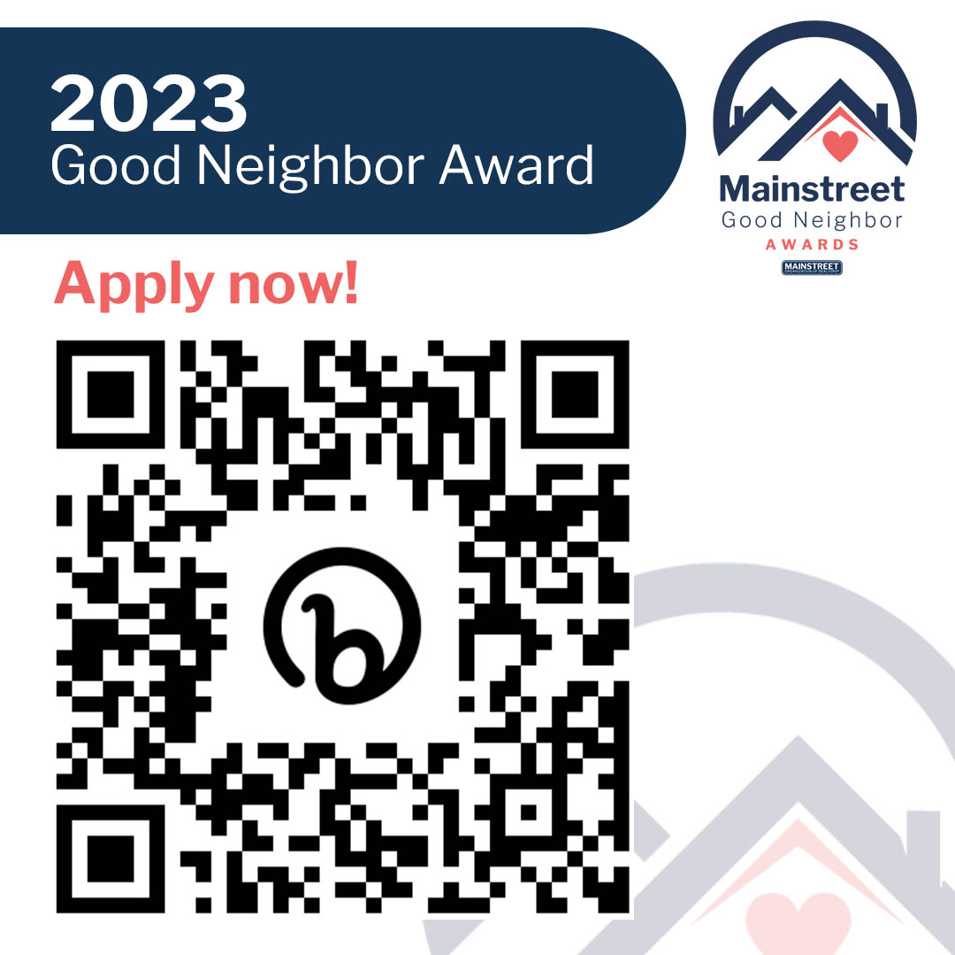
UPCOMING COURSES AND EVENTS
6.6 Book Club: The Art of Gathering
6.8 Commercial Boot Camp
6.12 Build Your Resource Team – Senior Services
6.14 Margery Shinners Memorial Golf Event
6.21 Coffee & Conversation: 60 Nuggets in 60 Minutes
6.21 Mainstreet REALTORS® & The Alliance Networking Event
SucceedWithMORe.com/calendar

