Slide 1
SEPTEMBER 2023
BROKER SLIDES

Slide 2
UPDATED EXCLUSIVE BUYERS REPRESENTATION AGREEMENT
NEW Paragraph 6 Retainer Fee: Buyer agrees to Brokerage a non-refundable retainer fee of $ _ due and payable upon signing of this Agreement. Said retainer fee (Check one) shall or shall not be applied towards any Brokerage Fee owed by Buyer to Brokerage.
Revised Paragraph 7 Compensation: Goes into more detail about what happens if the Brokerage is paid more than the amount on lines 74/75.
Lines 80-86: If the amount being offered by the seller or seller’s brokerage, including any bonus, exceeds the Brokerage Fee, Designated Agent(s) shall disclose this to Buyer. Any amount being offered by seller or seller’s brokerage exceeding fee, up to $ or % of the purchase price may be:
☐ retained by Brokerage
☐ refunded to Buyer, or
☐ negotiated at the time of purchase agreement.
Rev. 7.2023

Slide 3
BILL AIMS TO CLARIFY INDEPENDENT CONTRACTOR STATUS
The Direct Seller and Real Estate Agent Harmonization Act(link is external) (H.R. 5419), which was introduced in the House on Tuesday, seeks to amend the Fair Labor Standards Act of 1938 to clarify the definition of “employee” by incorporating the Internal Revenue Code recognition of direct sellers and qualified real estate agents as “independent contractors.” Proponents of the bill, which is sponsored by Rep. Tim Walberg (R-Mich.), say it offers a clearer and more universal statutory standard.
FAQs on independent contractor status in real estate
“This classification is essential to the real estate and direct selling industries,” NAR and the DSA said in their joint statement. “A clear statutory standard is critical to protecting the livelihoods of direct sellers and real estate agents supporting consumers across America.”
Read full article HERE

Slide 4
NEW SENTRILOCK BOX
The new SentriGuard Lockbox officially launches at Mainstreet on October 5 during Oktoberfest! Stop by the Mainstreet Table to demo.

Slide 5
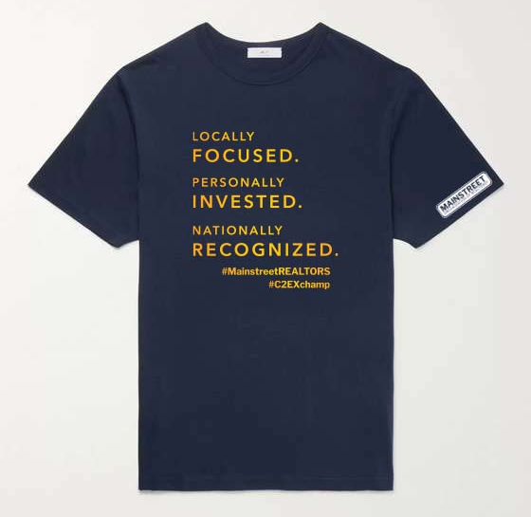
COMMITMENT TO EXCELLENCE (C2EX)
Completed your C2EX endorsement? Congratulations, you’re eligible for a free t-shirt and pin. Email Lynnette@succeedwithmore.com to schedule a pickup at one of our four locations or grab yours at Oktoberfest!

Slide 6
UPCOMING COURSES AND EVENTS
10.3.23 Seller Representative Specialist (SRS)
10.5.23 Oktoberfest
10.19.23 Coffee & Conversation: How to Talk to Buyers
10.21.23 Boost: Goal Driven Real Estate (New Member)
10.24.23 45 Hour Post Licensing
10.30.23 45 Hour Post Licensing
SucceedWithMORe.com/calendar

